Slide 1
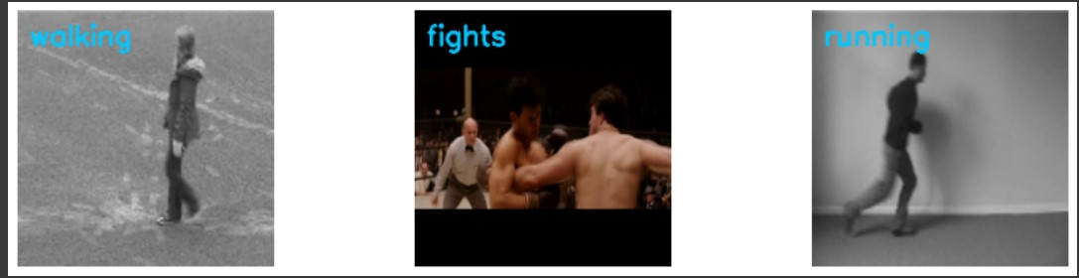
A LRCN approach to Human Activity Recognition
By: Vishnu Khokhar
102003199
G19

Slide 2
Summary:
Introduction
Related Work
Proposed Approach
Experimental Approach
1. Dataset used
2. Model Configuration
Result and Discussion
1. Accuracy
2. Real time Demo
Conclusion

Slide 3

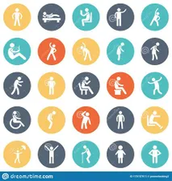

Introduction
Human Activity Recognition data resources
Smart Watches
Smart Phones
Vision Based Approach
IMU device

Slide 4
Introduction
Applications
Human Computer interaction
Healthcare
IOT
Security
Approaches to Human Activity Recognition
Deep Learning
Machine Learning

Slide 5
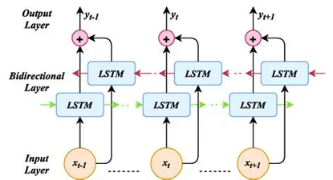

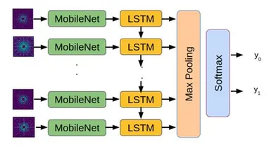
Background:
Human Activity Classification Algorithms
1. Support Vector Machines
2. Computational Neural Networks
3. Long Short-Term Memory
4. Hybrid

Slide 6
Background
Challenges
Most approaches require domain knowledge and expertise
Very high resource utilization( Memory , processing power etc)
Need for very complex models
Solutions:
Deep Learning
Approaches have been proposed in the past that utilize different architectures
CNN – spatially deep
LSTM – temporal deep
I proposed a model that leverages the strengths of both the approaches for human activity recognition

Slide 7
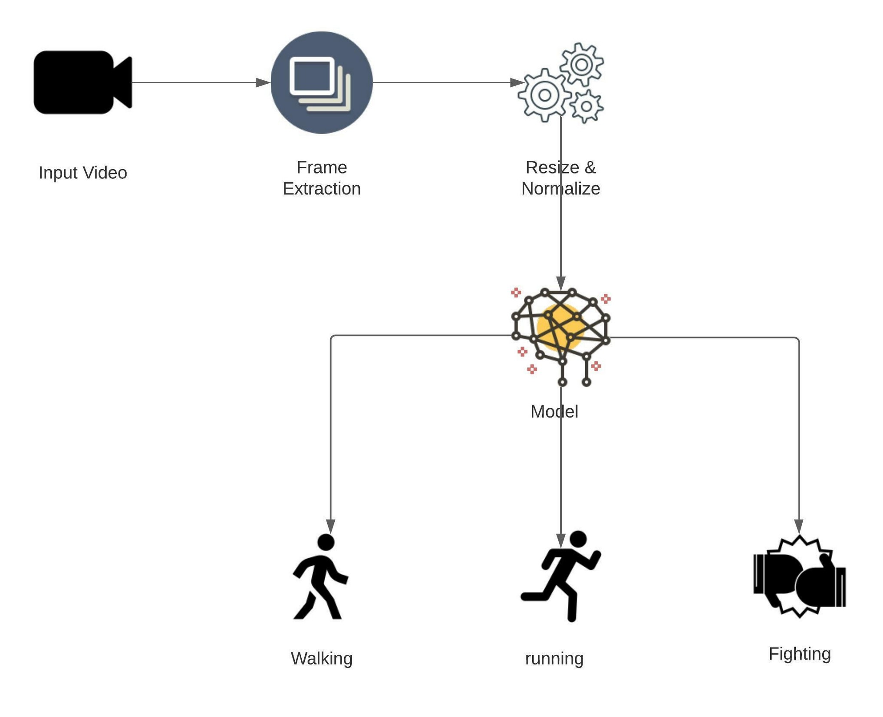
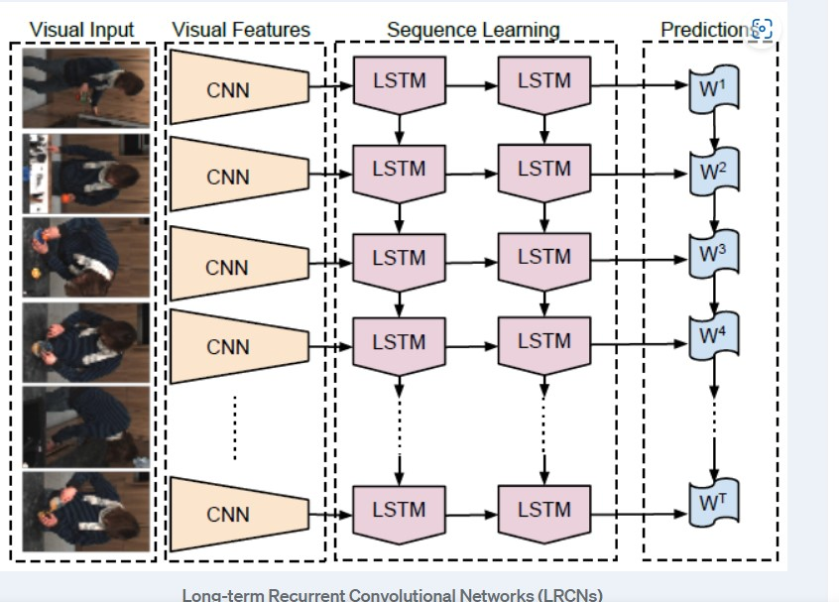
Proposed Approach

Slide 8
Dataset Used
KTH Dataset for running and walking
collection of sequences representing 6 actions
each action class has got 100 sequences.
Each sequence has got almost 600 frames and the video is shot at 25 fps.
Kaggle Dataset for fighting
Consists of, over 100 videos taken from movies and YouTube videos

Slide 9
Model Configurations
LRCN Model (CNN + LSTM)
12 CNN layers
Frames are 64 x 64 size
100 videos/class
Epochs = 70
Batch size=4
Validation split = 0.25

Slide 10
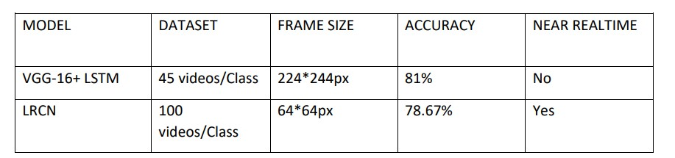

Results
Proposed approach was evaluated on two dataset
Compared to other approaches
Performed really good

Slide 11
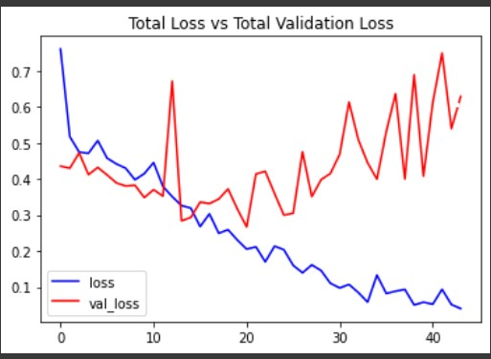
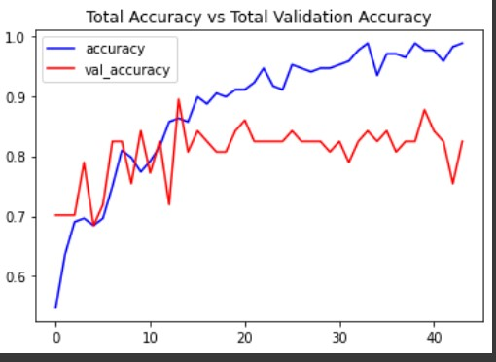
The total loss is decreasing during the training phase which is the expected behaviour as our objective is to minimize the loss
The Testing accuracy is lower than training accuracy and hence there is a tendency towards overfitting.

Slide 12
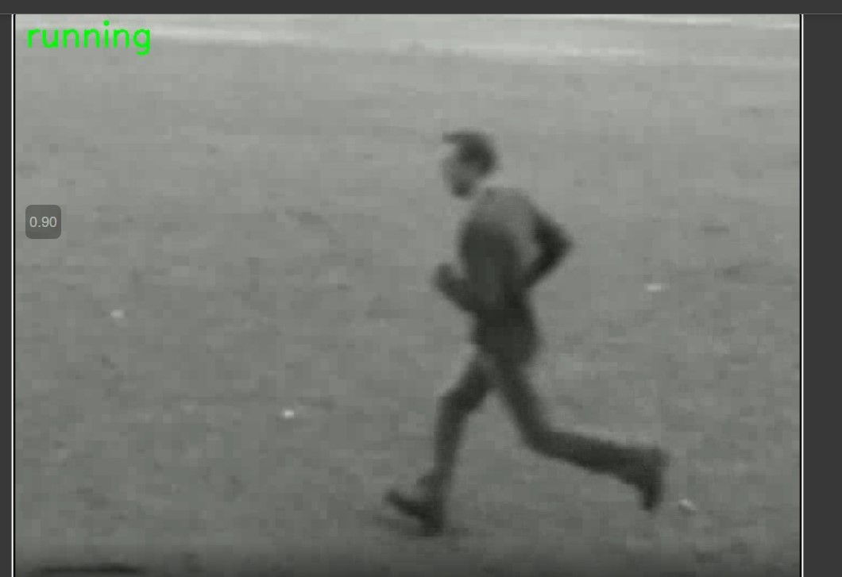
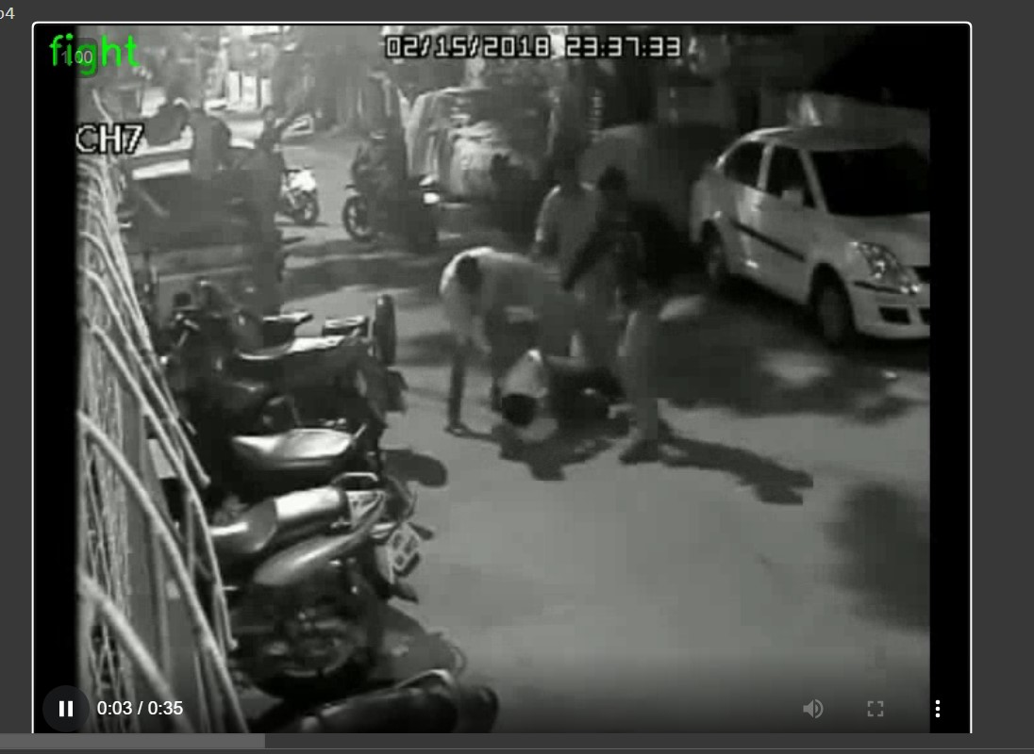
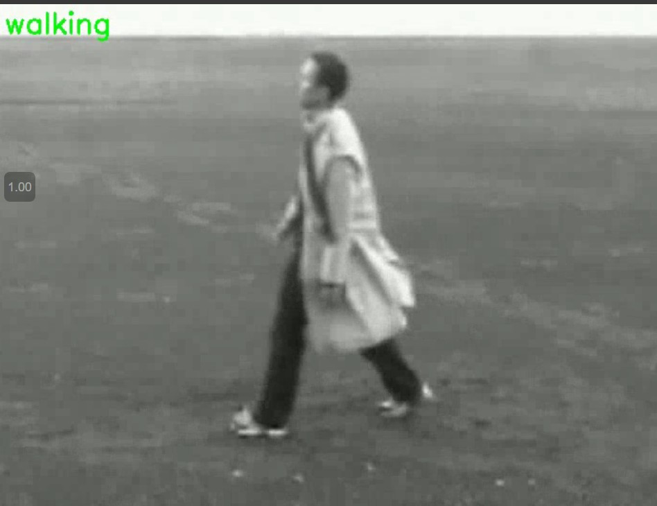

Slide 13
Conclusion
Proposed a LRCN approach to human activity recognition
Model is both spatially and temporally deep
By leveraging automated feature extraction of CNN and
Classification of LSTM
Compared the performance of LRCN model to other models
Predictive accuracy
Doesn’t take too long to train
Short prediction time
Future work
Learning complex activities
Evaluation on other publicly available datasets

Slide 14
Thank You

